Slide 1


Discover the World with Our Tour and Travel Website
Welcome to our website, your gateway to unforgettable travel experiences. We offer a wide range of expertly curated tours and travel packages, catering to all tastes and budgets.

Slide 2
Responsive Design with Tailwind CSS
Mobile-First Approach
Tailwind CSS Framework
Responsive Layouts
Our website is designed with mobile users in mind, ensuring a seamless and enjoyable experience on all screen sizes.
Tailwind CSS allows us to create a visually stunning and modern interface while keeping our code clean and maintainable.
Content adapts dynamically to different screen sizes, ensuring optimal readability and user interaction.

Slide 3

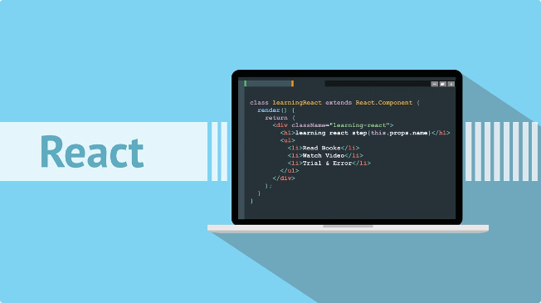
Seamless User Experience with React
1
Fast and Efficient
2
Interactive Elements
React's virtual DOM and component-based architecture ensure lightning-fast page loads and a smooth user interface.
React allows us to create interactive components such as search filters, carousels, and forms for a dynamic and engaging experience.
3
Dynamic Content
4
Easy Maintenance
React's ability to handle dynamic content updates in real-time provides a personalized and engaging user experience.
React's modular structure simplifies code maintenance, ensuring that updates are efficient and bug-free.

Slide 4


Comprehensive Tour and Travel Packages
Guided Tours
Adventure Vacations
Explore iconic landmarks and hidden gems with our expert guides who provide insightful commentary and local knowledge.
Thrill-seekers can choose from a range of adventure packages, from hiking and cycling to whitewater rafting and rock climbing.
Luxury Escapes
Family Trips
Indulge in luxurious accommodations, fine dining, and exclusive experiences at top destinations worldwide.
Create unforgettable memories with your family on our curated trips designed for all ages, offering fun and educational experiences.

Slide 5

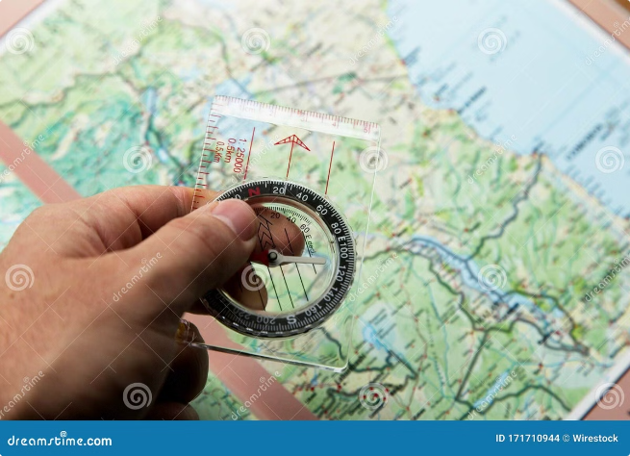




Personalized Trip Planning and Recommendations
Advanced Search Filters
Smart Recommendations
Our search filters allow you to refine your search based on budget, interests, travel dates, and other preferences.
Based on your preferences, we recommend personalized itineraries and destinations tailored to your interests.
Expert Travel Advice
Save Your Favorites
Our team of travel experts is available to provide personalized recommendations and assistance in planning your trip.
Create a wishlist of your favorite destinations and tours to easily access and manage your trip planning.

Slide 6

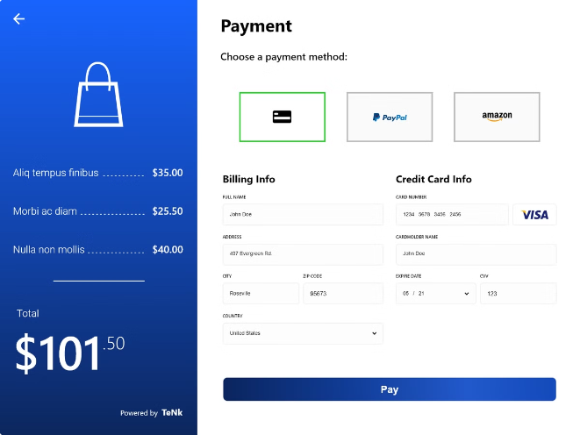
Secure and Convenient Booking Process
1
Browse and Choose
Explore our wide range of tour and travel packages and select the one that best suits your needs.
2
Secure Payment
Our secure payment gateway protects your personal and financial information during the booking process.
3
Instant Confirmation
Receive immediate confirmation of your booking, along with detailed travel information and itinerary.
4
Manage Your Trip
Access your booking details, manage your itinerary, and contact customer support through your online account.

Slide 7





Detailed Destination Information and Guides
Destination Pages
Discover comprehensive information about each destination, including its history, culture, attractions, and practical tips.
Interactive Maps
Browse interactive maps to explore the layout of cities, find points of interest, and plan your itinerary.
Local Guides
Access detailed guides with recommendations on restaurants, shops, activities, and hidden gems in each destination.

Slide 8


Testimonials and Reviews from Satisfied Customers
Testimonial 1
Testimonial 2
Testimonial 3
"Our trip to Italy was absolutely amazing! The tour was well-organized and our guide was knowledgeable and friendly. Highly recommended!"
"We had a fantastic time on our family vacation to the Bahamas. The accommodations were excellent and the activities were perfect for all ages."
"The customer service was exceptional. We had a minor issue with our booking, but the team quickly resolved it and went above and beyond to ensure our satisfaction."

Slide 9
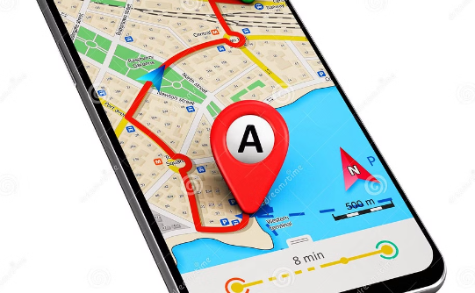
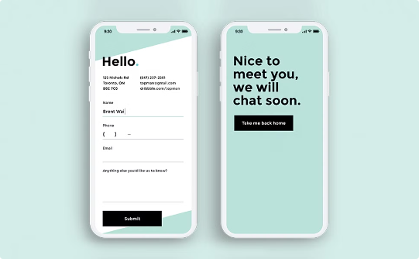
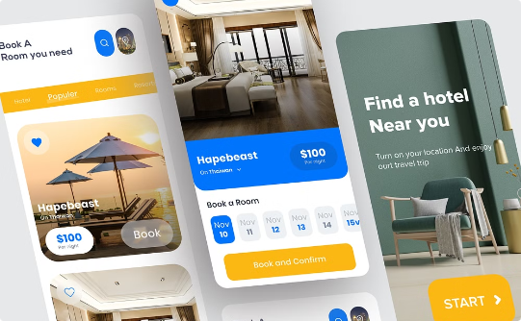
Mobile-Friendly Features and Functionality
Responsive Navigation
Easy Booking
Offline Access
Our website is designed to adapt to different screen sizes, providing a smooth and intuitive navigation experience on mobile devices.
Book your tours and travel packages directly from your mobile device, with a streamlined and user-friendly booking process.
Download your itineraries and travel guides for offline access, so you can easily access your information even without internet access.

Slide 10


Contact Us for More Information
For any questions or assistance with booking, please contact our friendly and knowledgeable customer support team. We are available to answer your inquiries and assist you in planning your dream vacation.
Team Members
Aditya Sharma → aditya3755.be21@chitkara.edu.in
Mehak Sharma → mehak3810.be21@chitkara.edu.in

